Slide 1


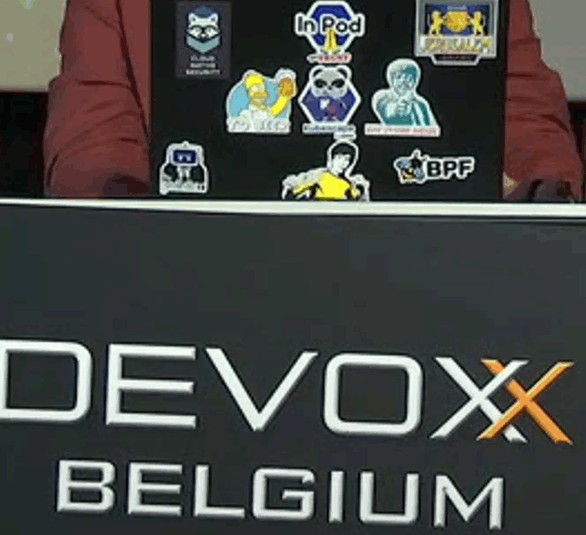
Report from Devoxx 2022 Ideas, Tips, Inspiration for software engineering
Report from Devoxx 2022
The State of Software Engineering

Slide 2

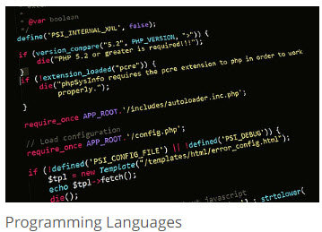
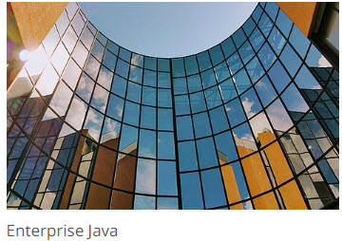



Themes

Slide 3
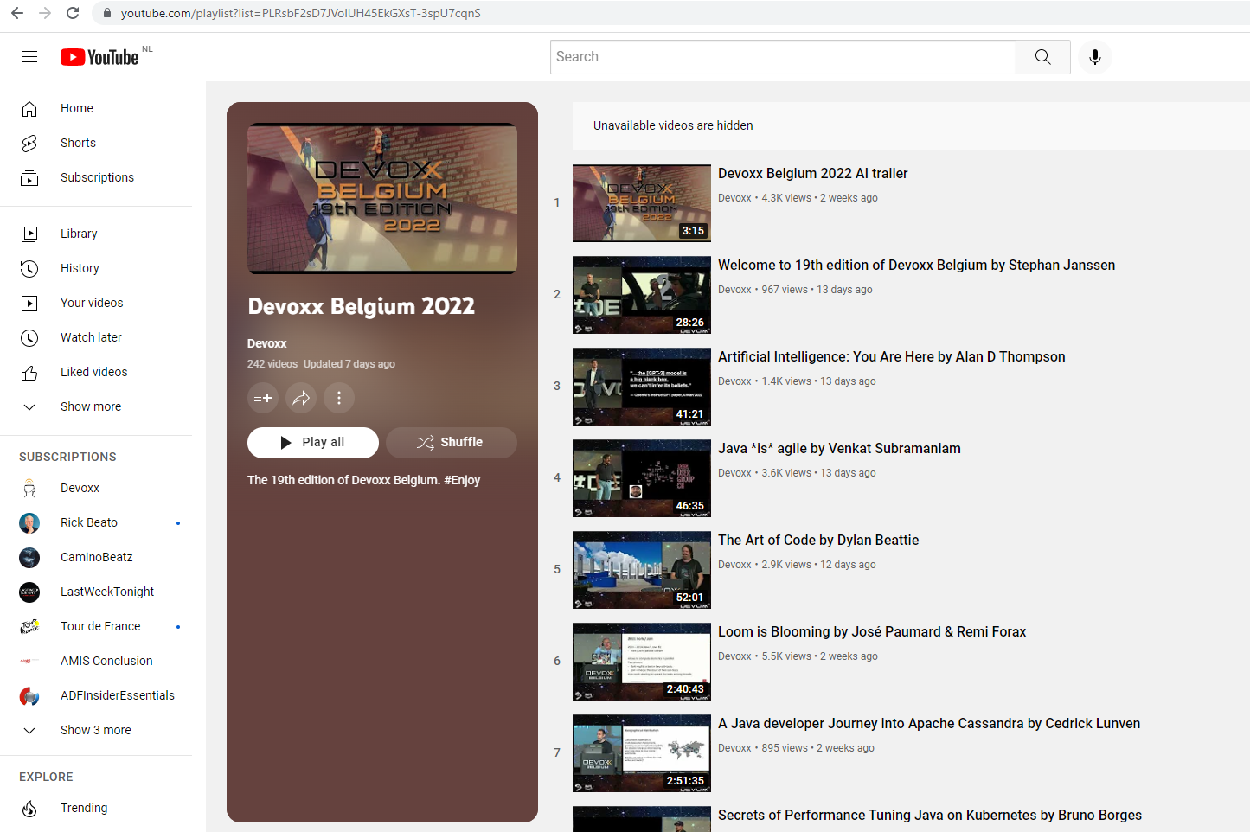

Reassurance
All sessions can be watched on demand:
www.youtube.com/playlist?list=PLRsbF2sD7JVolUH45EkGXsT-3spU7cqnS

Slide 4
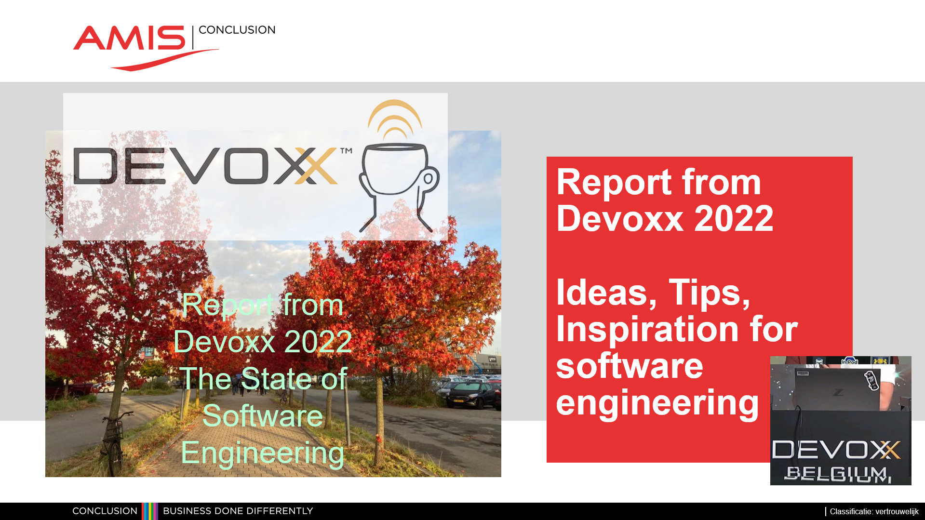
Reassurance
Slides from this session can be downloaded

Slide 5
Caveats

Slide 6

Implicit
Java (11 at least; moving to 17LTS)
Maven, Gradle
Git, GitHub / GitLab
JUnit (& Jest)
SpringBoot
Containers (and Kubernetes)
Jenkins
Apache Kafka
React | Angular | Vue
VS Code | JetBrains IntelliJ IDEA
PostgreSQL
Redis
Node (JS)
Okta (sometimes KeyCloak)
PetClinic (Spring Reference Application)

Slide 7
Other topics
Women in Tech
Sustainability
Content Governance – Tournesol
Programming Languages:
Java, Kotlin, JavaScript,
SQL
Python, Go, Rust, Scala, Perl
No: C#, C, C++, Dart, R, Swift, PHP, Ruby

Slide 8

What was not at Devoxx?
Backstage – to create developer portal
Flutter (cross platform UI framework)
Oracle and IBM
Alibaba
NetBeans (or Eclipse)
MySQL (or MariaDB)
Puppet, Ansible, Salt
VR/AR , Metaverse
Crypto currency
ChatBot
Low Code (well, … perhaps a little bit?)
Cloud

Slide 9

Java
Java 19 – September 2022
Concurrency (Loom) – Virtual Threads (Loom) and Structured Concurrency (composite unit of work)
Foreign Function Interface & Vector API (Panama)
Smaller language improvements (Amber) – pattern matching in switch
Current LTS: Java 17 September 2021
Next LTS: Java 21 , September 2023
Notes:
https://github.com/CRaC/docs

Slide 10
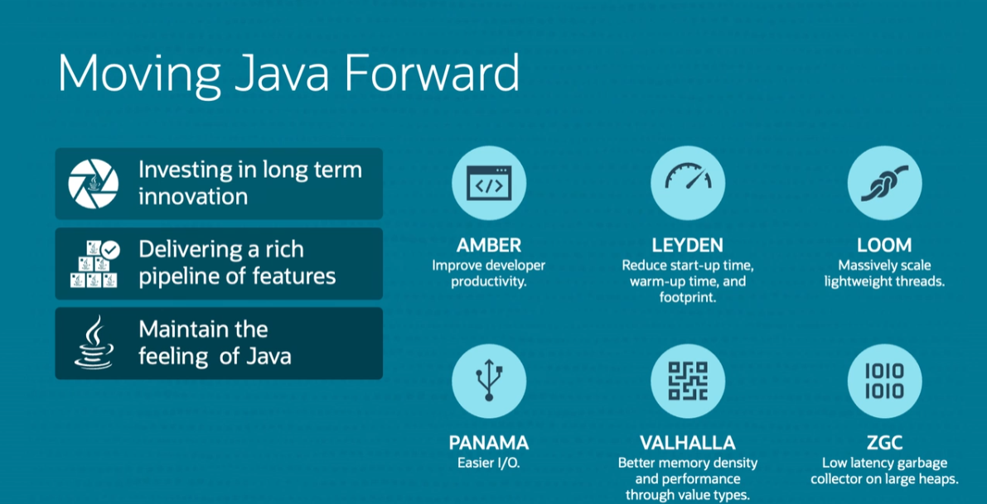

Slide 11
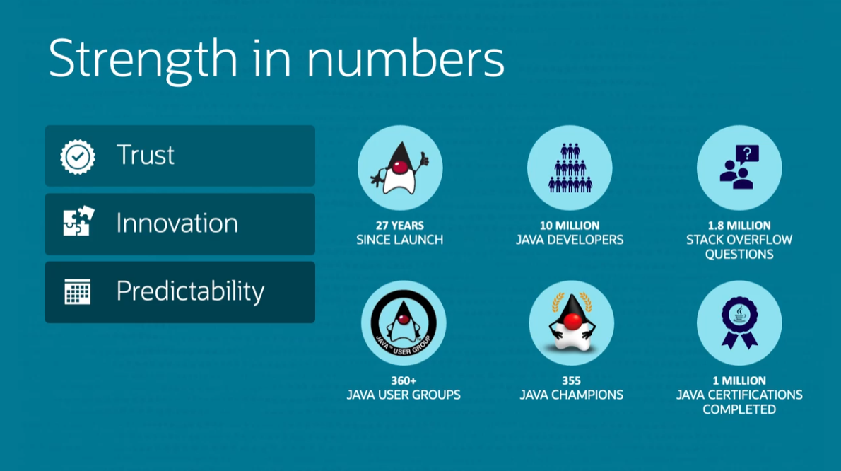

Slide 12
Java Application Development
SpringBoot
Quarkus
Micronaut, Helidon
Jakarta EE
JHipster (& JHipster Lite)
layered architecture vs hexagonal architecture

Slide 13
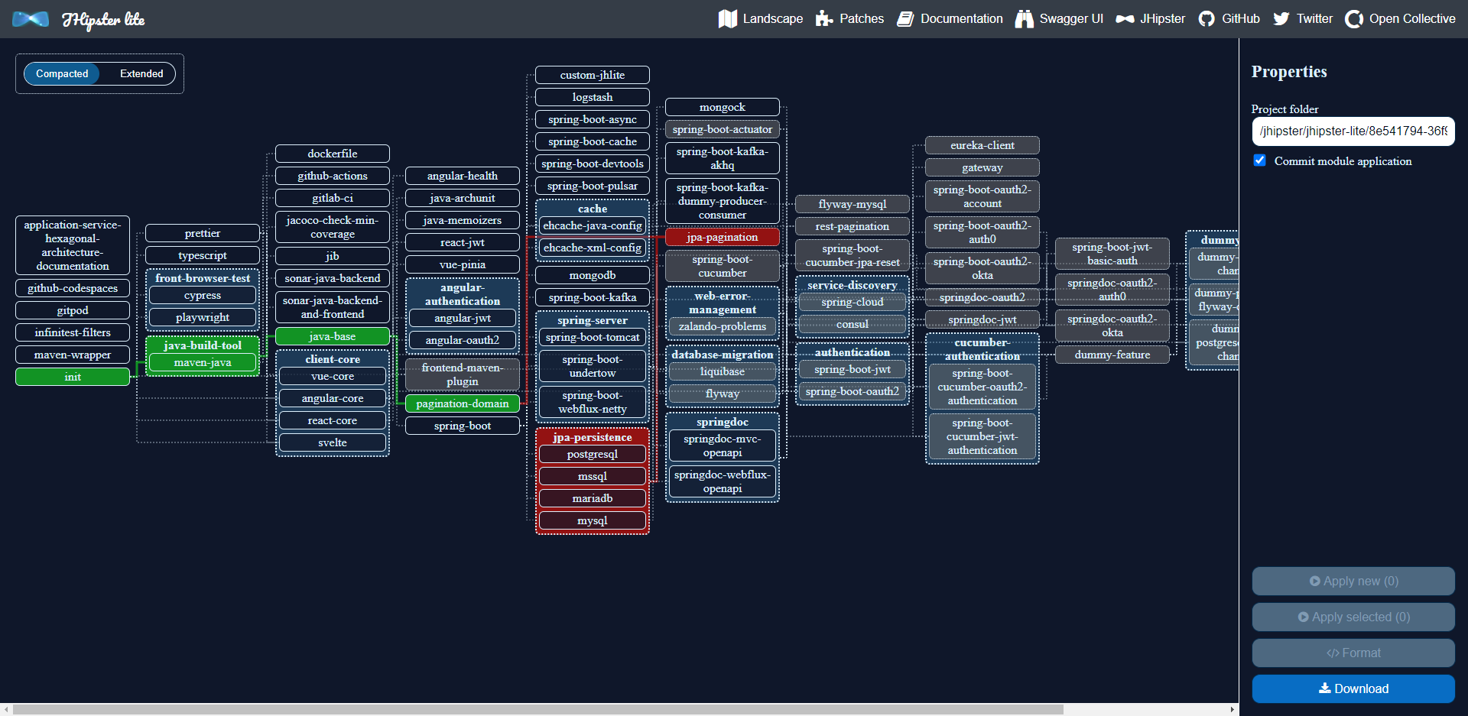
JHipster
Generate Java project – best practices
all configuration & dependencies
database
APIs
frontend
authentication, monitoring
tests, build scripts
Lite: composability, extensibility, maintenance
step by step – application “assembly”
not just web-apps
Git integration
100% test coverage
Testcontainers
Notes:
https://lite.jhipster.tech/landscape

Slide 14
Frontends & UX
Frontend
Notes:
https://github.com/GoogleChromeLabs/comlink
https://developer.chrome.com/docs/workbox/

Slide 15

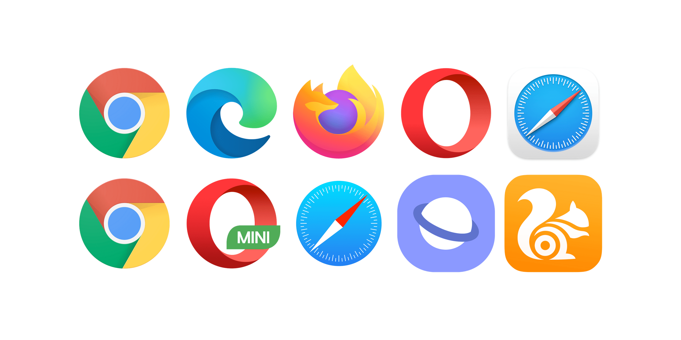
The New Application Server
user customizations, 3rd party plugins, accessibility, history, dev tools
HTML, SVG, images, video, audio, 3D
input from keyboard, mouse, touch
workload – run JavaScript, WebAssembly, (embedded Node, Python)
workload – run parallel threads (main thread per tab, background threads for web workers, service workers
Windows
Linux
macOS
Android
iOS
Notes:
https://3dviewer.net/index.html#model=assets/models/car.glb

Slide 16
The New Application Server
user customizations, 3rd party plugins, accessibility, history, dev tools
HTML, SVG, images, video, audio, 3D
input from keyboard, mouse, touch
workload – run JavaScript, WebAssembly, (embedded Node, Python)
interface with camera, microphone, speaker, gamepad
network – http(s) 1.1/2/3, certificate verfication, SSE, WebSockets, WebRTC, BlueTooth, NFC
interact with OS: file system, screen lock & brightness, desktop app, scheduling, notifications, clipboard, USB, Location, Device Sensors, share
data persistence – cookies, Local Storage, IndexedDB, FIleSystem API
workload – run parallel threads (main thread per tab, background threads for web workers, service workers
Windows
Linux
macOS
Android
iOS
Notes:
https://3dviewer.net/index.html#model=assets/models/car.glb

Slide 17


The Big Three

Slide 18
The Big Three

Slide 19
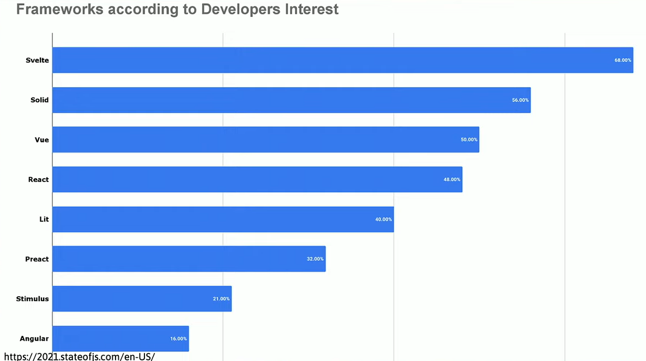
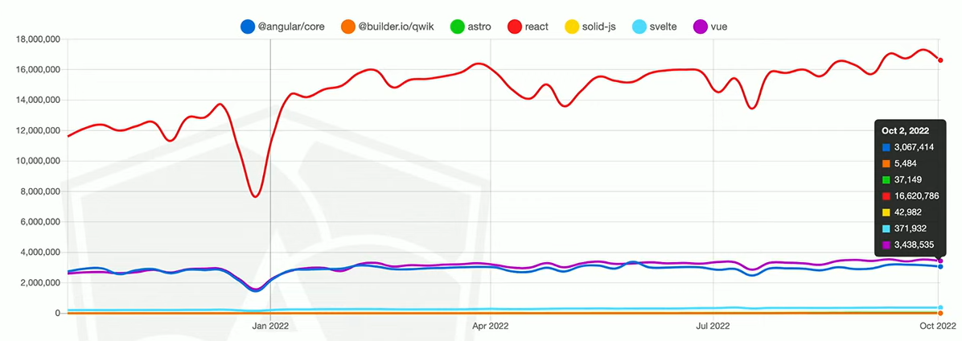
The Big Three

Slide 20
The Big Three?

Slide 21
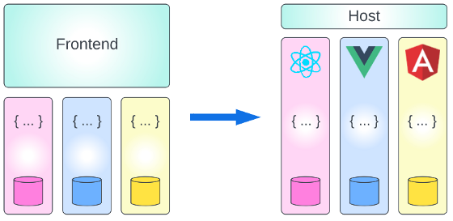
Microfrontends
Microservices architecture – single, centralized, monolith frontend?
Combine different versions of React in a single user experience
upgrade part of the application – but not all of it
Combine different frameworks in a single user experience
build a new feature with a new frontend framework

Slide 22
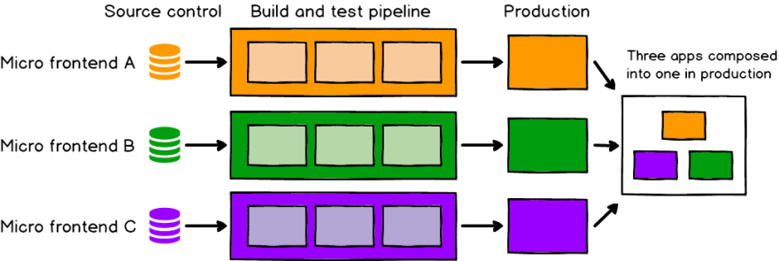
Microfrontends are here: Webpack Module Federation
Webpack Module Federation
Runtime composition – each module is built and deployed separately
Shell application with routes to “modules”
Shared libraries

Slide 23



Big Topic – Performance as experienced by user
Time-to-interactive & Responsiveness to User Action
Themes: load less, load later
compress, compile
load 3rd party dependencies asynchronously - Partytown
load through ES Modules (i/o fully bundled applications)
server side rendering – React Server Components, Astro
lazy loading (on demand hydration) - Qwik
Notes:
https://2021.stateofjs.com/en-US/libraries
https://github.com/builderio/qwik
https://github.com/BuilderIO/partytown

Slide 24
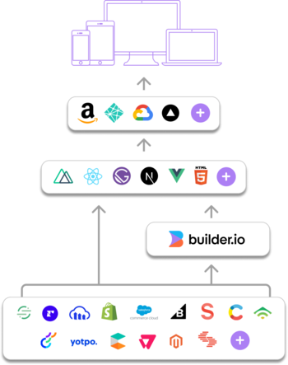


Builder.io – Visual CMS
From creators of AngularJS, Ionic, Stencil
Also: Mitosis
Compile Components from JSX to other frameworks (React Native, Angular, Svelte, Solid)
edit components visually in Builder.io
Notes:
https://github.com/BuilderIO/mitosis

Slide 25
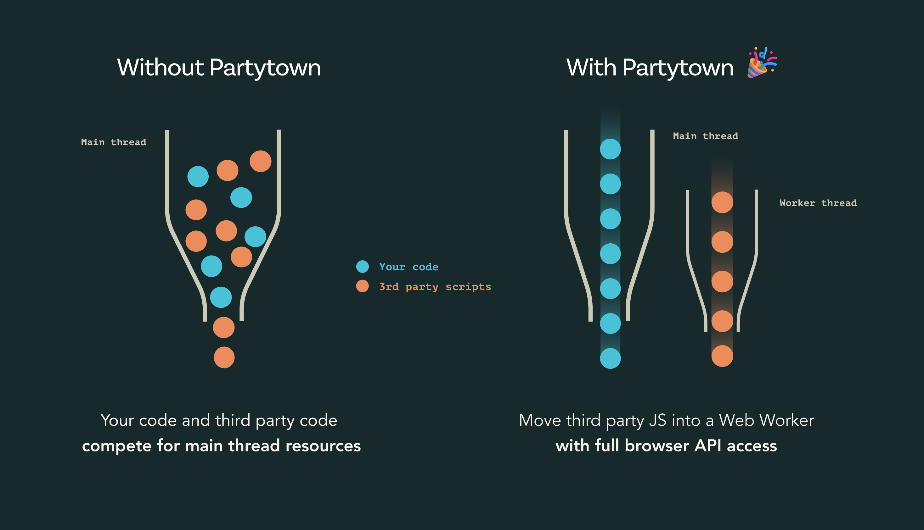
WebWorker and ServiceWorker
Browser JavaScript Main thread
Background threads: WebWorker (and ServiceWorker)
limitations for example in accessing the DOM
can be made to perform work no behalf of but not blocking main thread
ComLink – easy interaction between main thread and WebWorkers
Partytown – “control 3rd party library loading inside WebWorker”
Proxy API in browsers: wrap/replace any JavaScript object
Off Line usage of Web Application – Service Worker
npm Workbox module
Notes:
https://github.com/GoogleChromeLabs/comlink

Slide 26

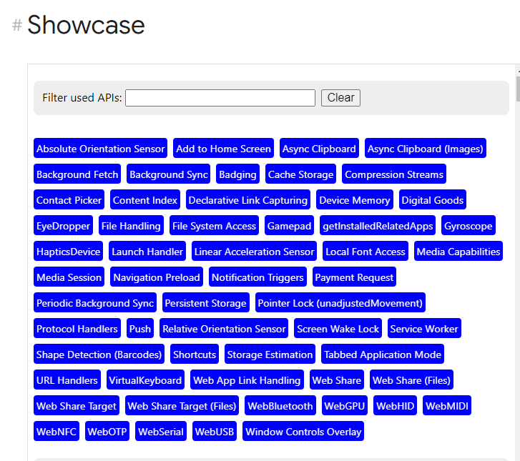
Web Capabilities – Project Fugu
a cross-company effort with the objective of making it possible for web apps to do anything iOS, Android, or desktop apps can, by exposing the capabilities of these platforms to the web platform, while maintaining user security, privacy, trust, and other core tenets of the web.
Notes:
Web Capabilities – Project Fugu
https://developer.chrome.com/blog/fugu-status/
https://developer.chrome.com/blog/fugu-showcase/

Slide 27

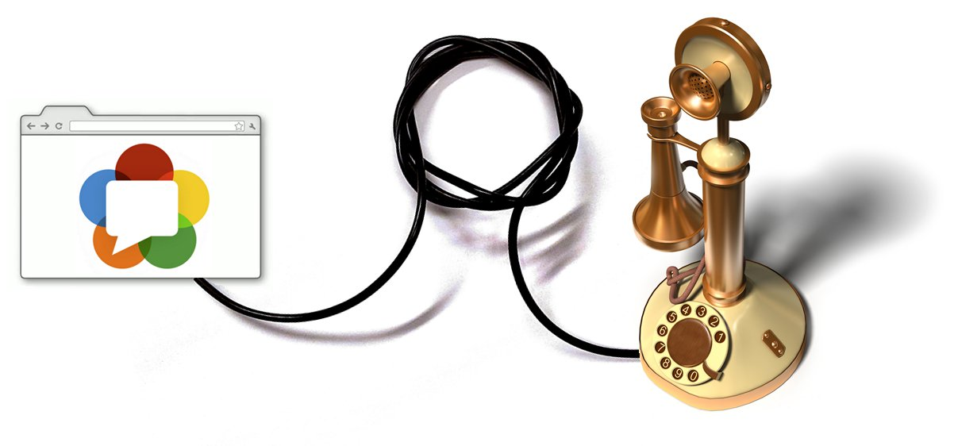
WebRTC
RTC = Real Time Communication
Supported in all major browsers and evolved by Apple, Google, Microsoft and Mozilla, amongst others
Browsers are peers in peer-to-peer streaming communication
video – camera, screensharing
audio – microphone, speaker
transmit text or files
Note: WebRTC allows interaction between different browser tabs or different local browser
Also: local video recording and replaying
Notes:
https://webrtc.org/

Slide 28

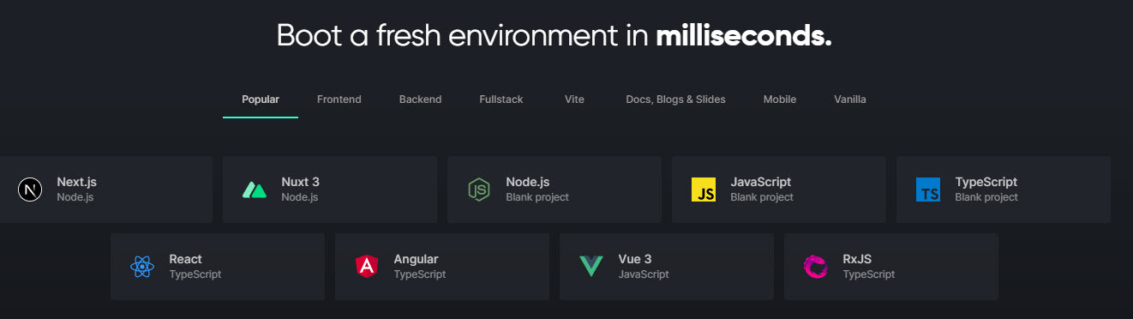
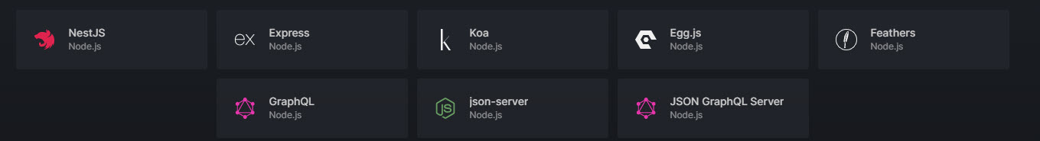
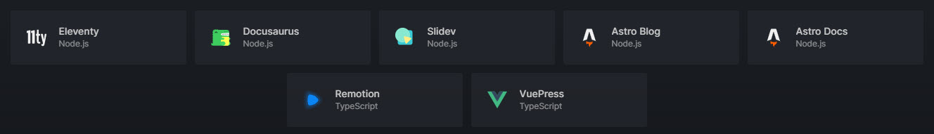
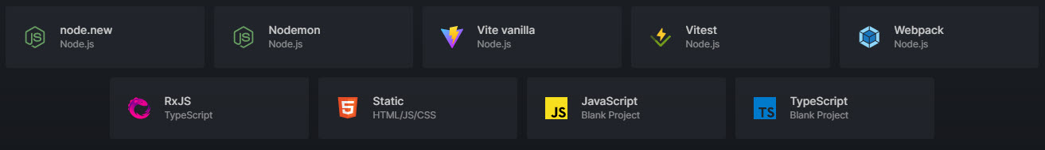
StackBlitz: Instant Browser Based Development Environments
Notes:
https://stackblitz.com/edit/jfgreffier-try-playwright-test-eac1pg

Slide 29

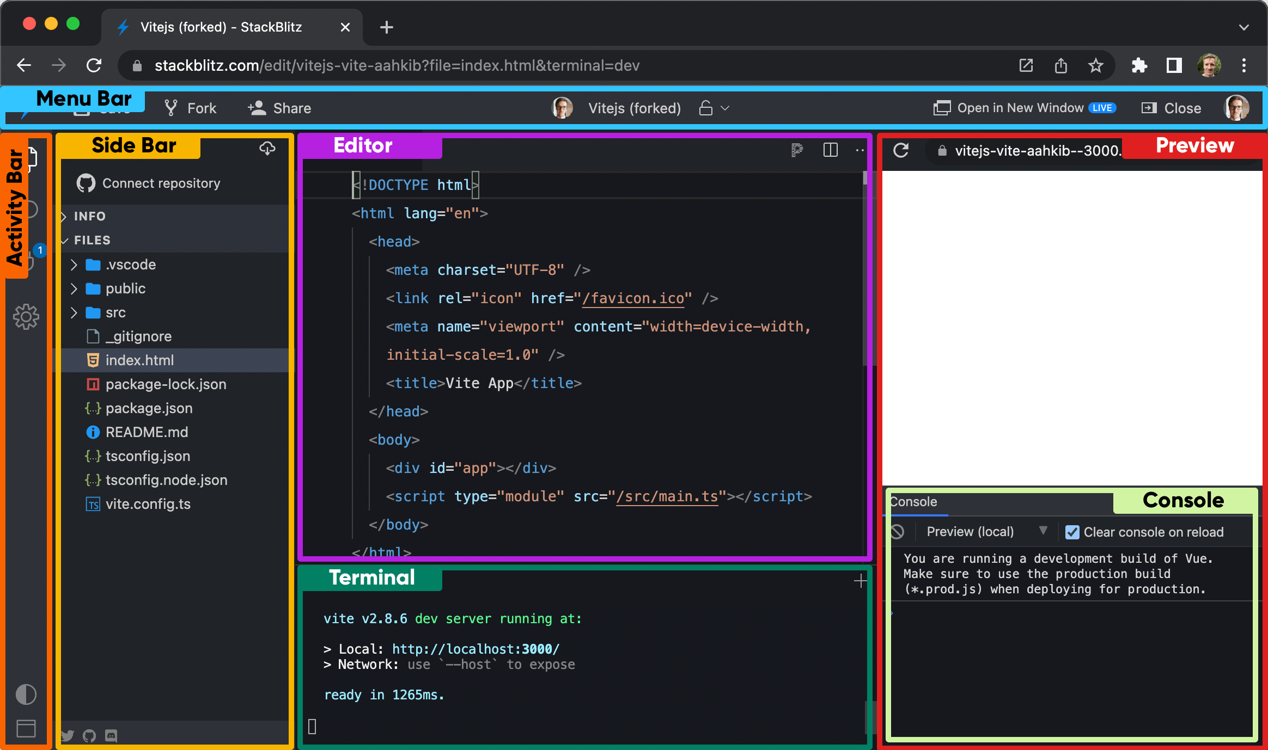
StackBlitz
Built on WebContainers (WebAssembly based Node in the browser)
Use cases:
Tutorial
Bug Reproduction
Quick Demo
Rapid Prototyping
Playground, Try Out Stuff
(interactive) Documentation
Run:
Load Project from local file system
Open repo from GitHub
Create project through NPM SDK
Notes:
https://developer.stackblitz.com/

Slide 30

AI
LLM (large language model) Transformers
Models trained on Bs of records (Wikipedia, Books, Reddit, …)
Can write text, assemble music, generate images and videos
StableDiffusion 100% open source, september 2022 – Keras CV
(Dall-E, Google Parti, GPT-3 is blackbox, Roberta, ..)
inpainting, outpainting, latent walk: move from image A to image B, add term plus associated images
Google Colab – free Python Jupyter Notebook environment
OpenAI Playground
Huggingfaces
KerasCV
OnceUponABot
Imagen - https://imagen.research.google/video/
Notes:
beta.openai.com/examples
https://imagen.research.google/video/

Slide 31
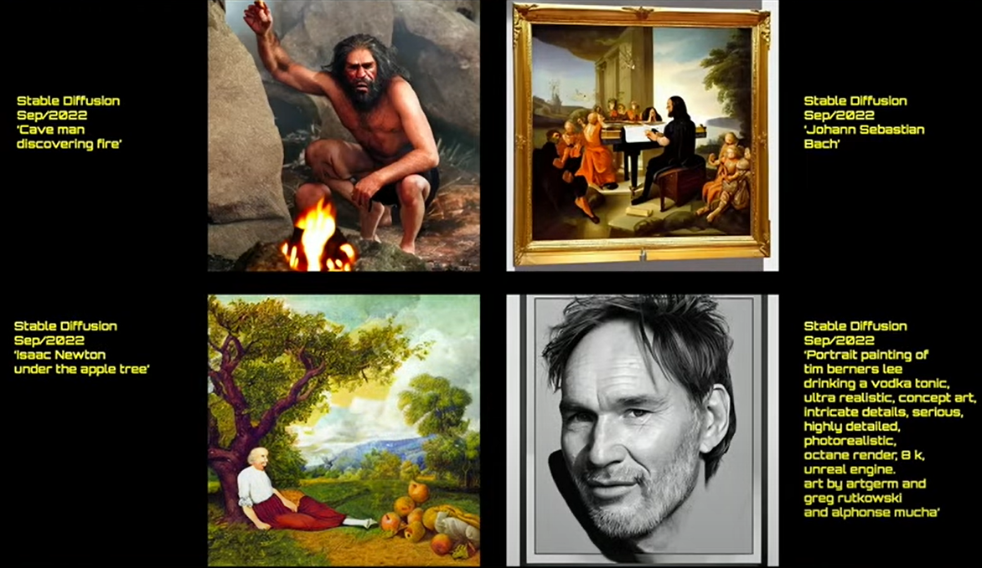
Notes:
https://parti.research.google/

Slide 32
Notes:
https://parti.research.google/

Slide 33


Slide 34
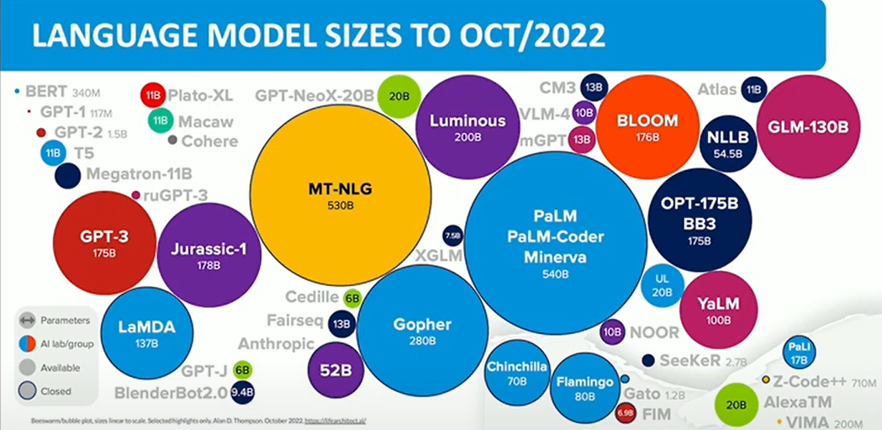

Slide 35
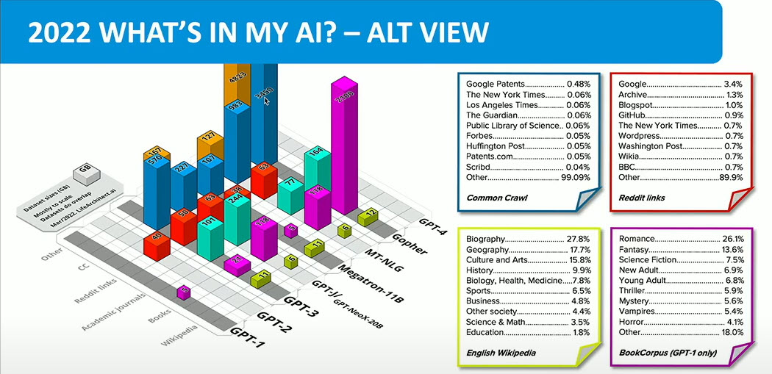
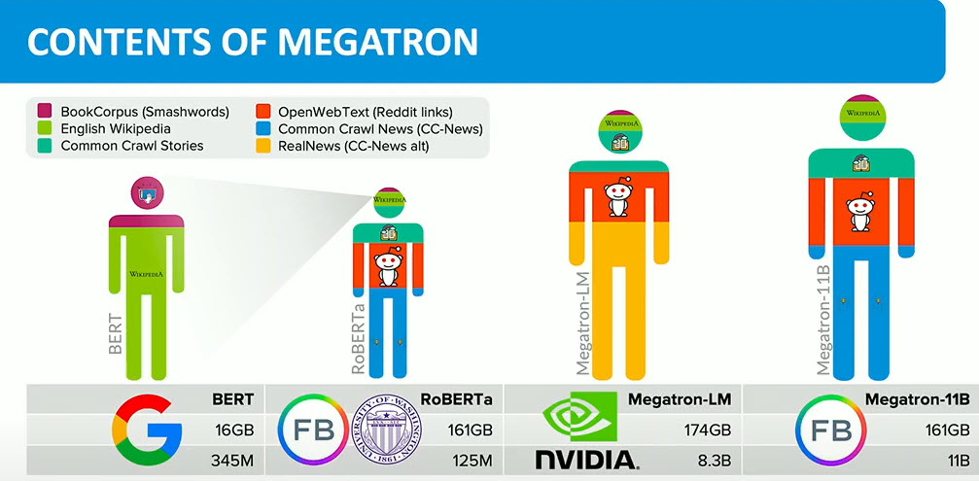
Notes:
https://huggingface.co/datasets/bookcorpus

Slide 36
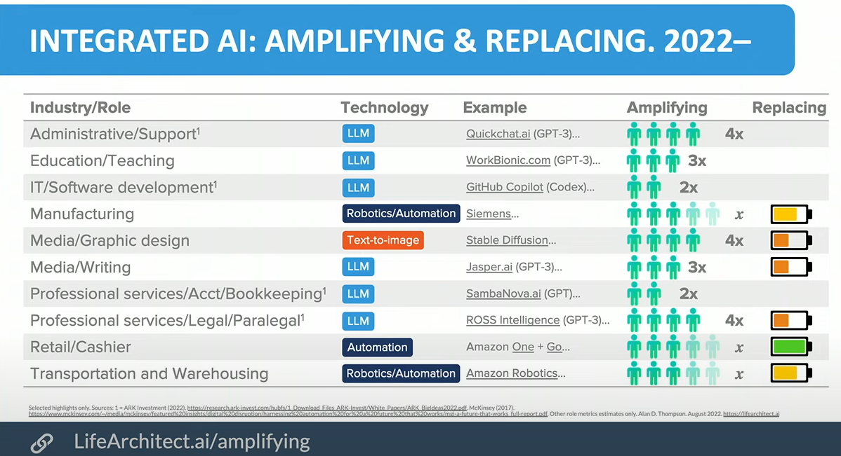

Slide 37
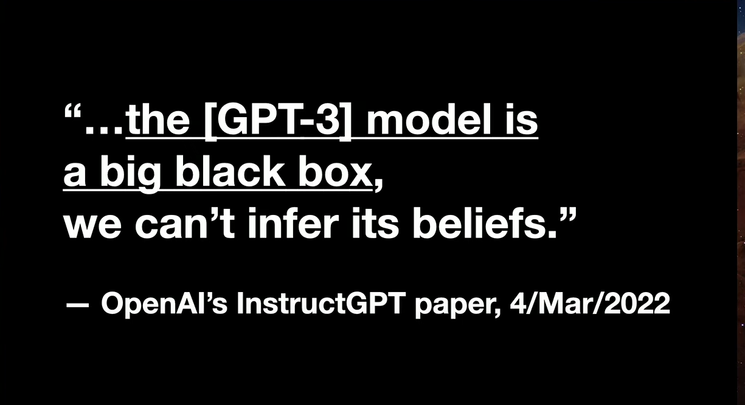

Slide 38
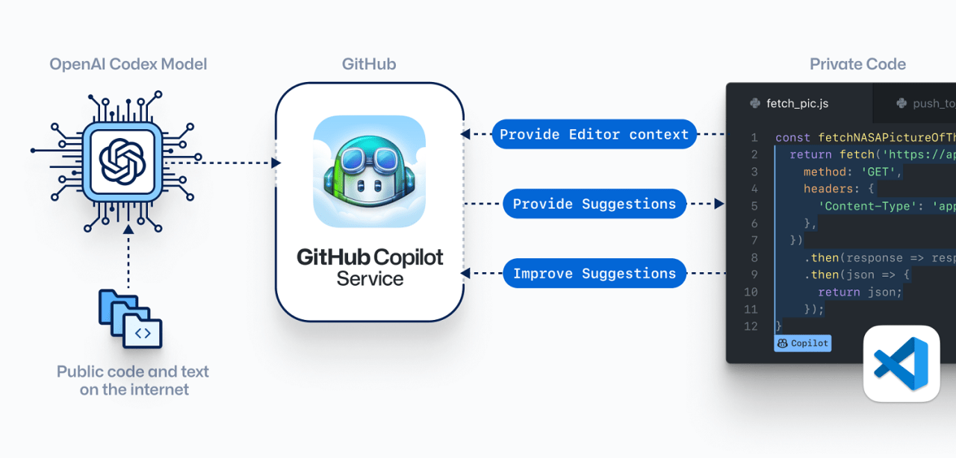
AI in programming
GitHub CoPilot
AWS Code Whisperer Google Alphacode
BlueDiff Cover
CodeGeeX

Slide 39
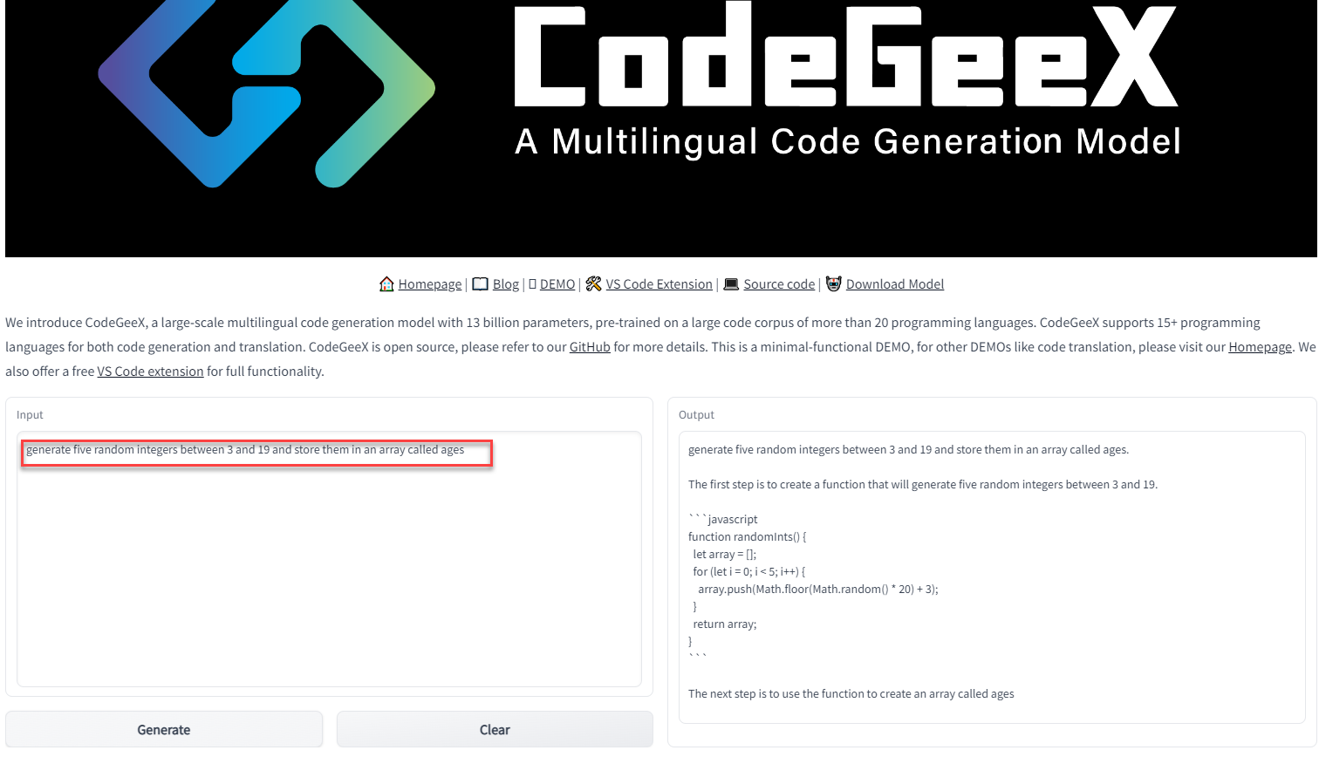
Generate Code from “specification”

Slide 40
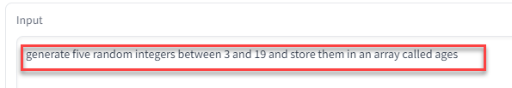
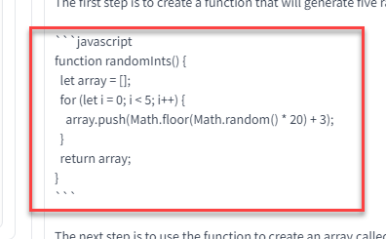
Generate Code from “specification”

Slide 41
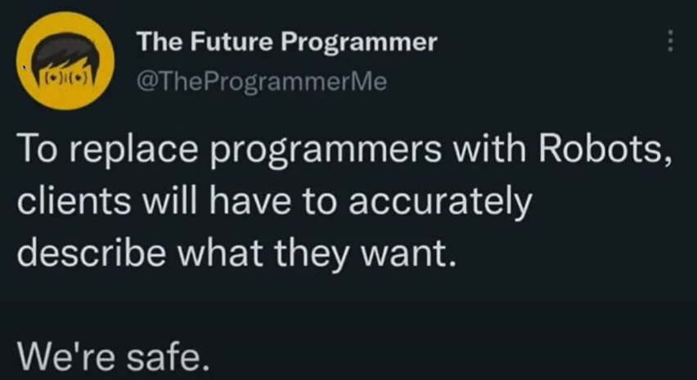

Slide 42
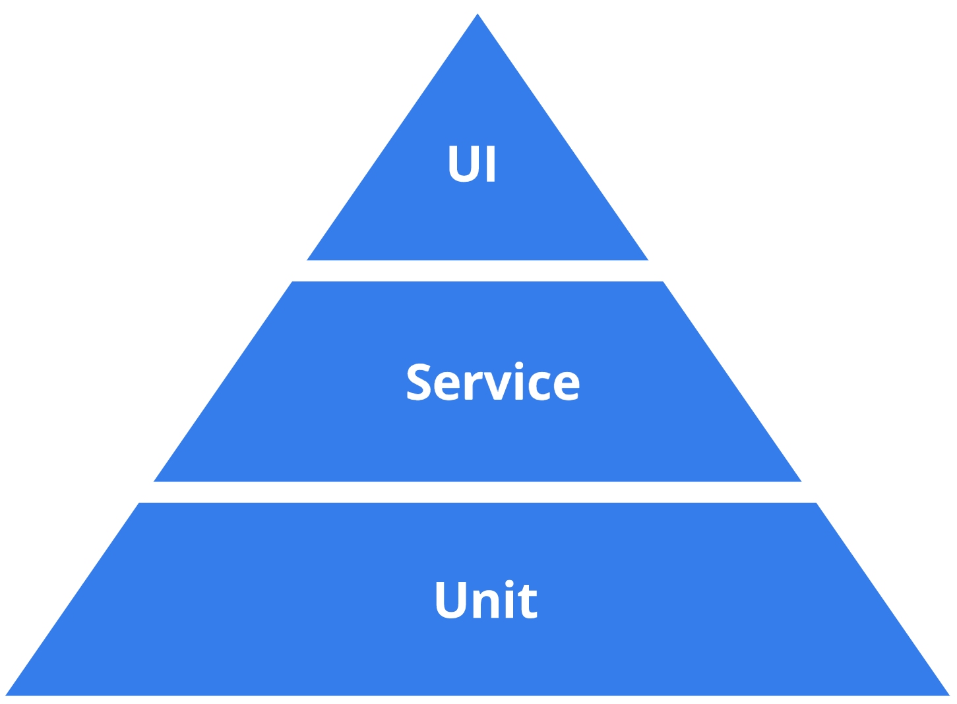
Test
Prevent Bugs
Find Bugs
Prevent Regression
Bug?
incorrect or lacking behavior
incorrect non-functional
error / unclarity in docs
technical debt

Slide 43
Test
behavior
feature
end to end / integrated
penetration
load
integration
contract
development
production
artefact scanning
smoke
health check
BDD
TDD
regression testing
chaos
periodic in-production-testing
Lint
Code QA
unit
fuzzing
mutation testing

Slide 44
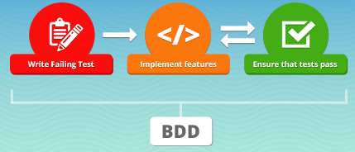


(End-to-end | Integrated | Behavior) (Regression) Testing
Consider (all of) the application a black box
Test if for a certain input the <system> responds in the required manner
output, side effects, logging, non-functionals
BDD:
Tools:
Cucumber – describe tests in functional terms and generate code stubs
support for virtually all languages
Playwright – test UI scenarios from within (fully controlled) browser
SDK for JS, Python, Java, .NET
Notes:
https://cucumber.io/docs/installation/

Slide 45
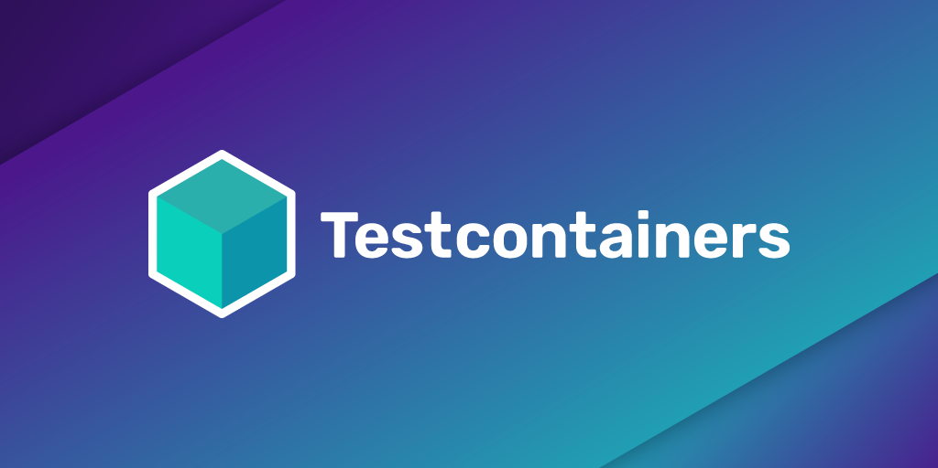
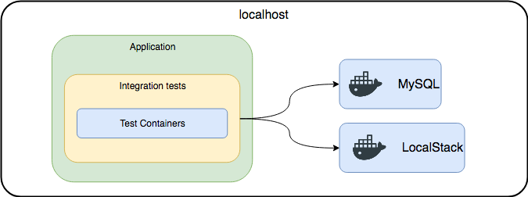
Testcontainers
Integration Tests with real platform components
actual technology, version, interaction protocols
running locally in containers
no (complex, incomplete mocks or poor substitutes)

Slide 46
Testcontainers
Integration Tests with real platform components
actual technology, version, interaction protocols
Support for Java, Node/JS, Python, .Net, Go
Create regular tests using test framework (JUnit, Jest, Go test)
Programmatically orchestrate containers with database, web server, message broker, ftp server etc
Manipulate containers – configure port, inject environment variable, copy files; read container runtime properties
Testcontainer Modules available for tailor made configuration and interaction
for example Kafka, PostgreSQL, Azure, RabbitMQ, Oracle-XE, WebDriver, MySQL, ToxiProxy
or start GenericContainer from any container image
Testcontainers takes care of starting containers before all tests and stopping after the tests are done
Other tools to programmatically manipulate containers – such as Dockerode

Slide 47

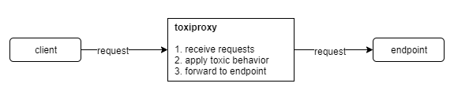
ToxiProxy – Chaos Testing on Network
Run ToxiProxy between application under test and endpoint
Endpoint can be any TCP/IP destination:
REST API, gRPC endpoint, Database, Kafka, Queue, Cache, FTP, ..
ToxiProxy is instructed to “mess up” connections
latency, drop, bandwidth, slice, timeout, limit_data
Configure ToxiProxy programmatically (e.g. from Unit Test) or from CLI

Slide 48
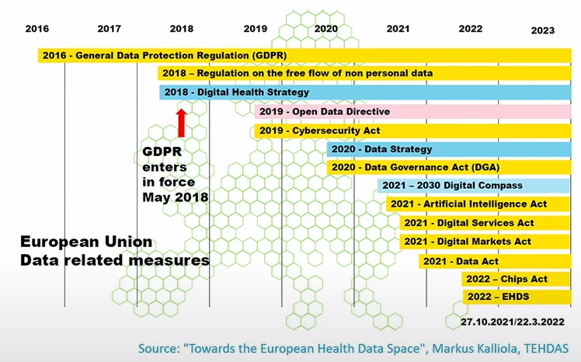
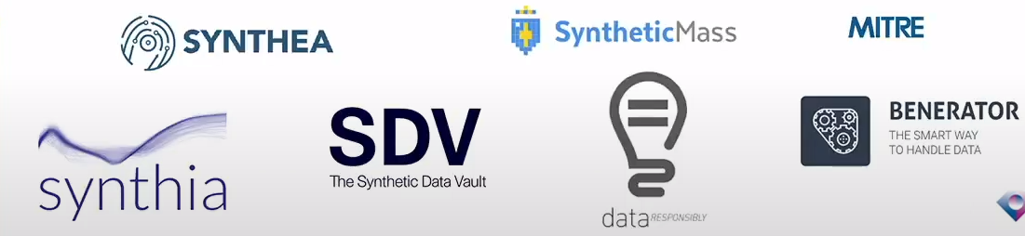
Test Data
Production Data
for existing systems
Pseudonymized, Anonymized
Synthesized
Consistent
Tools
SDV (Python)
Notes:
https://sdv.dev/

Slide 49
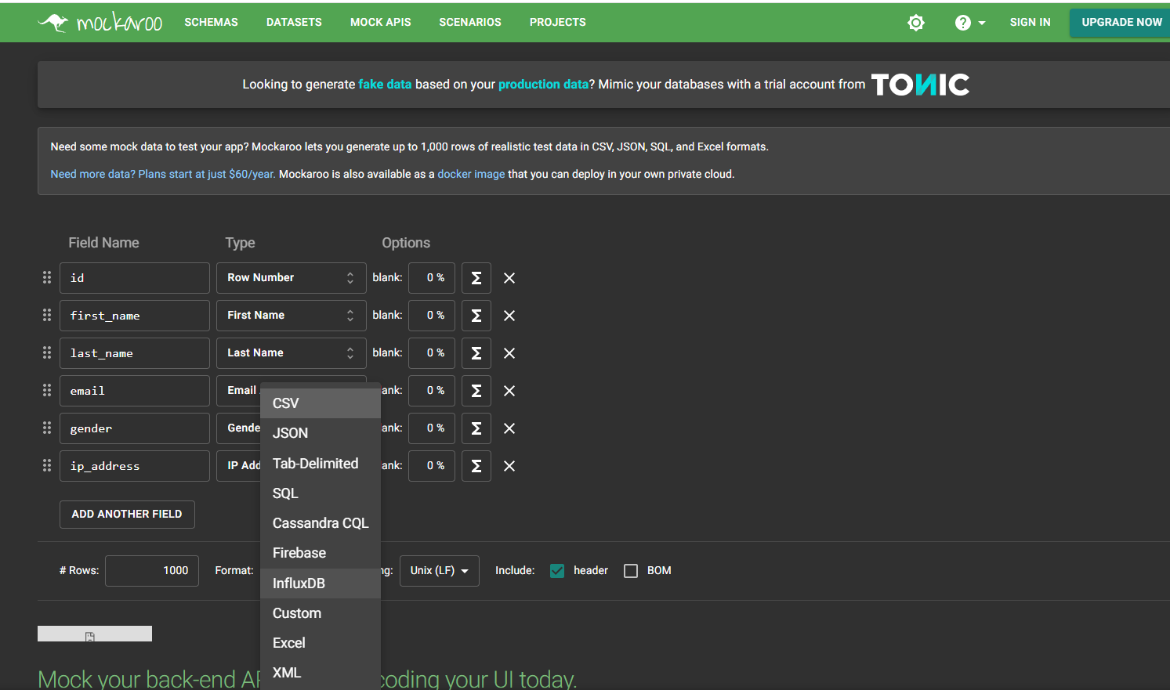
Test Data - Generate
Prevent test blindness from having a static (small) data set
Data Faker (in Java, Ruby, Python, Perl, JavaScript)
more than 200 Fakers (types of data – airports, names, telephone numbers)
60+ locales supported
Mockaroo – web UI for defining schema and downloading data
JSON, SQL (DML), CSV, XML
200+ predefined field types
define custom list of allowed values
use expressions to fine tune values
use RegExp masks to specify string patterns
also publish REST API that returns fake data
1K free requests per day
Notes:
https://www.datafaker.net/
https://github.com/Devskiller/jfairy
https://devskiller.com/datafairy/#/person?fromAge=21&toAge=65&size=50
https://www.onlinedatagenerator.com/
https://faker.readthedocs.io/en/master/
https://mimesis.name/en/master/

Slide 50
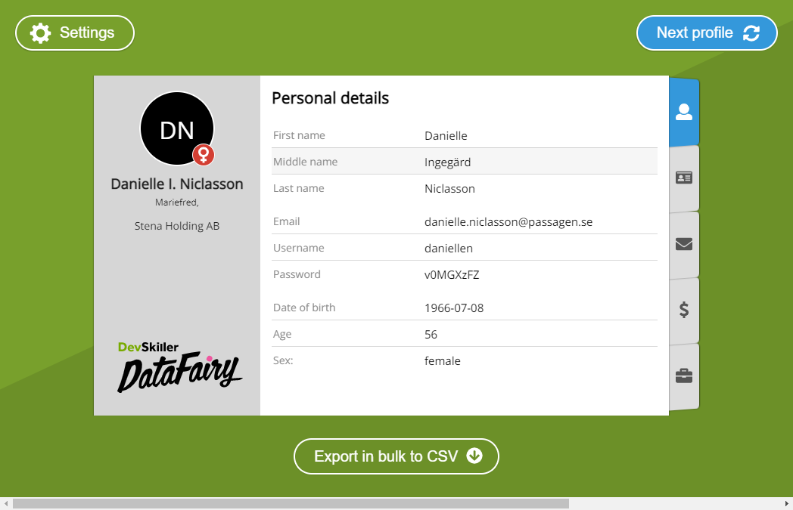
Test Data - Generate
Mimesis (Python)
jFairy – generates profiles (for people)
use in Java programs – consistent objects (email uses name)
produce in bulk (csv)
onlinedatagenerator.com
Mostly.AI
GenerateData
Commercial tools
Notes:
https://www.datafaker.net/
https://github.com/Devskiller/jfairy
https://devskiller.com/datafairy/#/person?fromAge=21&toAge=65&size=50
https://www.onlinedatagenerator.com/
https://faker.readthedocs.io/en/master/
https://mimesis.name/en/master/

Slide 51
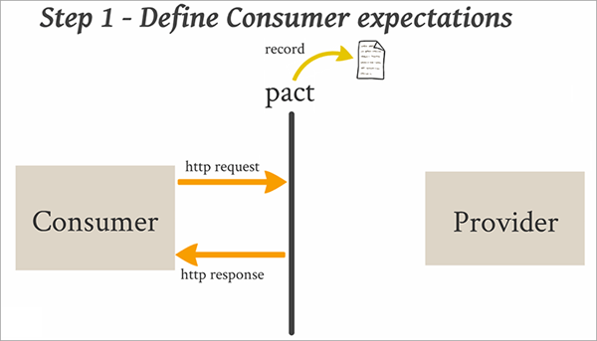
Contract Testing – regression test for all actual requests
Test the actual interactions from a consumer with a provider
1. Determine what the interactions are – the input and the response => this is the test set
2. (after each change in the provider and after each change in consumer’s expectation ) Test if the provider still responds as expected
using the “pacts” from all consumers with that provider

Slide 52
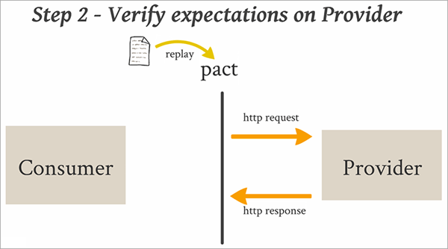
Contract Testing – regression test for all actual requests

Slide 53
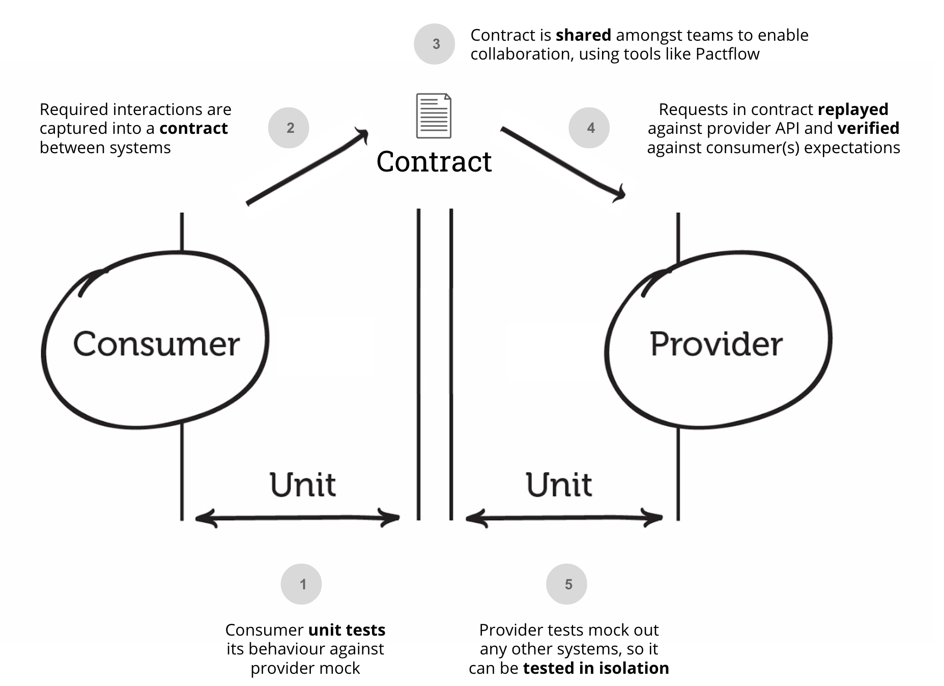

Slide 54


Tools for Contract Testing
Pact (SmartBear)
free version
commercial tool for contract testing
Spring Cloud Contract
SauceLabs -
Notes:
https://www.linkedin.com/pulse/api-contract-testing-visual-guide-peter-thomas/

Slide 55

Unit Test
Objectives:
Safe Refactoring,
Documentation (of how to use),
Validate (large number of) scenarios (edge cases),
Harden complex logic and calculations
Proof for <stakeholders> regarding code quality
Control 3rd party and platform dependencies (especially when upgrading)
For public interface methods, logic-heavy methods, methods with multiple code paths (high cyclomatic complexity), 3rd party libraries
AI assisted generation of Unit Tests (and test data samples) –
Bluediff Cover (Java),
Devmate (C#, Java), Ponicode (JS, TS, Python), Symflower Programming Assistant (Java, Go), GitHub Co Pilot (various languages)
Notes:
RestAssured
Awaitility
https://betterprogramming.pub/this-ai-tool-write-great-unit-tests-acfbfab53c09
https://www.softwaretestinghelp.com/best-automated-unit-testing-tools/

Slide 56
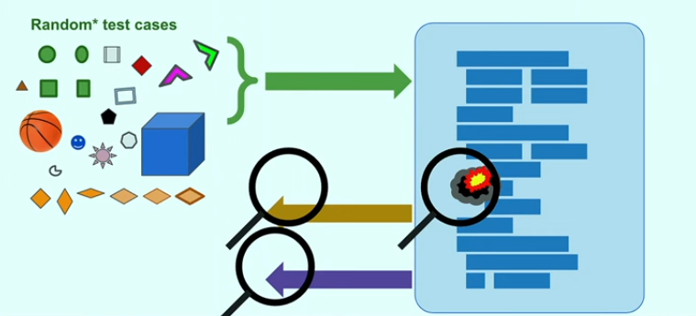
Fuzzing
Bombarding the “method under test” with different, semi-randomized inputs
trying to find “interesting” input values that extend code coverage
Tools available for different languages, Web Service and REST APIs
OSS-FUZZ: C/C++, Rust, Go, Python and Java /JVM code
Go 18
JSFuzz, JavaScript Fuzz

Slide 57
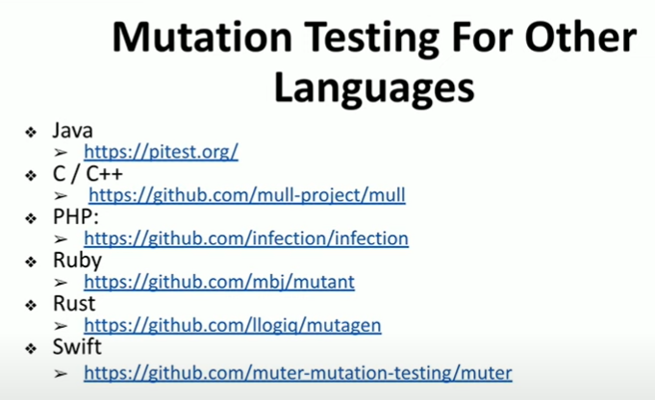
Mutation Testing – Test the Tests
At build time: inject mutants in the code
change static values, operators, function calls, regexp, decision logic, (remove) code blocks
Execute unit tests
Mutants should be detected by tests
Mutation Score: (number of killed / number mutations injected)
There are tools for creating mutants
Python: MutPy, Mutmut, mutatest
JavaScript: Stryker Mutator (also for Scala, C#)
Java: PIT (pitest.org)
Notes:
https://stryker-mutator.io/
https://slides.com/maha-alsayasneh

Slide 58








Test Tools
WireMock – mock HTTP APIs, record actual interactions; Testcontainers module
RestAssured – Java test library for REST services and JSON payloads
FlyWay, Liquibase – initialize database (schema & data)
ArchUnit – verify correctness of class dependencies (across boundaries)
Gatling, JMeter, Hey – load testing
Testcontainers
Playwright
OSS Fuzz
PIT
Pact, Spring Cloud Contract; OpenAPI test generation Schemathesis, Prism
Mockaroo, DataFaker
ToxiProxy
Cucumber

Slide 59
Code Quality
Manage Dependencies – check for newer versions, check for vulnerabilities and create PR with proposed updates
Maven
Dependabot, Renovate, Snyk
ErrorProne – find unwanted “code patterns”
Refaster – refactoring: rewrite occurrences of “before template” into “after template”
fix/improve vulnerabilities, benefit from new JDK features or frameworks upgrades
OpenRewrite –

Slide 60

Dependencies
Libraries
3rd party APIs
Cloud Services
Platform Components
Tools
Languages

Slide 61
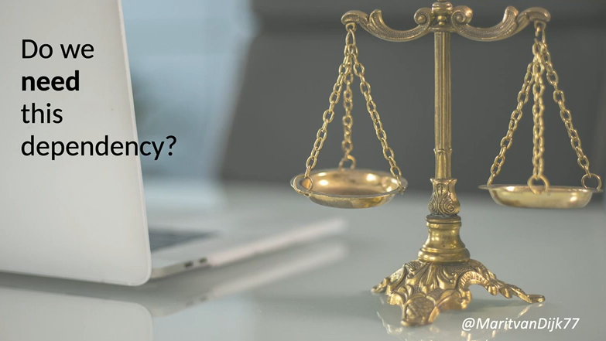

Dependency Management – Select with Care
Be mindful of the strings attached
Consider long term
Check status
active, mature/proven, sponsors & community, market share
Check security
Check indirect dependencies
Check on package-search.jetbrains.com
Create an Architecture Decision Record (ADR) – what, who, why, from where
Update the SBOM
Notes:
https://docs.sigstore.dev/

Slide 62
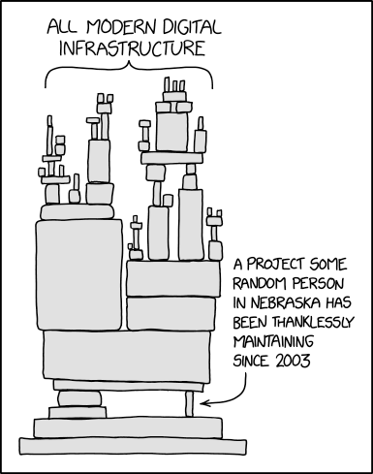
https://xkcd.com/2347/

Slide 63



Dependency Management – Add
check signature (make sure what you get is what you want)
2% of downloaders on Maven Central also downloads checksum
verify signature
optional: wrapper for dependency: access 3rd party component only through your own wrapper
test (for wrapper or for “required behavior of dependency”): special type of contract test
documentation on how to use
aid when upgrading
wrapper
3rd party component
Test
3rd party component
wrapper
Notes:
https://docs.sigstore.dev/

Slide 64


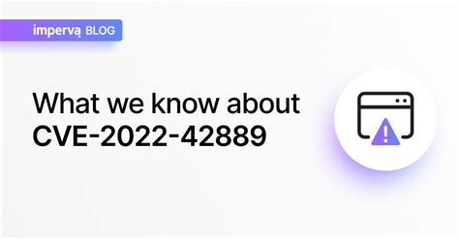



Slide 65




Dependency Management – Assess Your Dependencies
Know all your dependencies – direct and indirect
pom.xml, package.json
Maven & Gradle plugins
OSS Index SonaType
IDE
Bots for automated dependency management
Dependabot
Renovate
Snyk
GraalVM Native Image Inspection Tool

Slide 66
Dependency Management – Track Status
Security status (CVEs - Common Vulnerabilities and Exposure)
New releases
Community status
Bots help on first two aspects
Also: ossindex.sonatype.org

Slide 67




Slide 68
Dependency Management – Upgrade & Replace
Upgrade
Create a new ADR & Update the SBOM
Bots: Dependabot, Renovate, Snyk - create the PR with the update
Error-prone & Refaster, OpenRewrite – can help with refactoring
Test (the effect of the upgrade)!
Replace
select with care!
ADR, SBOM
reimplement wrapper or refactor code
Test
3rd party component
wrapper

Slide 69
Containers
Kubernetes

Slide 70

Container
Software is delivered as a container image
that contains all dependencies
(typically) on Linux
Container Image Registry
development
build
image
run
deploy
test
scan

Slide 71

Containers during Software Development
Using and producing containers is part of developer’s everyday work
Locally running containers for platform components during development
Testcontainers for (mock) services and platform components during test
Containers with tools for Code Quality Analysis, Linting & Building
Tools to run containers locally for example: Docker, Rancher, Podman
Run containers in the cloud: Azure Container Instance, OCI Container Instances, AWS AppRunner on ECS FarGate, GCP Cloud Run or run VM with Docker | Podman | Rancher

Slide 72



Java in Container – (not yet) Small & Frugal, Quickstart & Fast
Java Application (+ Java Runtime)
typically large (100s MB) & memory greedy
typically slow to start up & CPU hugging
Not ideal for containers nor serverless

Slide 73
Java in Container – Small & Frugal, Quickstart & Fast
Several initiatives for better Java Containers
Jib – build Java container images fast and easy
Portala (JEP386 ) – JDK for Alpine Linux & musl C library
CRaC – Coordinated Restart from Checkpoint
Project Leyden – Static Images (“closed world”)
GraalVM Native Image
Notes:
https://blogs.oracle.com/javamagazine/post/java-leyden-static-images - Leyden brings “GraalVM native images” to OpenJDK
(graalvm is separate)

Slide 74



Wonders of GraalVM Native Image
Produce a binary executable for your Java application
operating system specific native static image
Small, simple, frugal, fast, safe
Foundation for Quarkus, Micronaut, Helidon, Spring Native/Spring 6 & Spring Boot 3
Support for monitoring native image: VisualVM, GraalVM Insight, JFR, JMX (coming)
debugging native image execution

Slide 75

Ahead of Time (AOT) Compilation & Build
InspectTool to analyze class & method usages – Log4JShell, Apache Commons Text
Closed world analysis: all dependencies (the full tree)
which parts of the JDK, which libraries (direct and indirect) are needed
analyze code (by JIT compiling during build) and configured dependencies
AOT compiled output + Substrate VM + Heap with initialized objects + Resources

Slide 76

GraalVM is more than Native Image
GraalVM: Run Programs Faster Everywhere
Modern JIT compiler in JDK (much better compilation of modern Java | Kotlin | Scala constructs)
Truffle – one VM to run all languages
interoperability between programs in different languages
Tools

Slide 77


Handson Workshop at Conference
Download workshop resources to your laptop
over the conference WiFi
with 100s of other attendees
Or …
Linux VM

Slide 78
Gitpod – Cloud & Browser Based Development Environment
VM with VS Code & 10 language runtime + 20 tools
including Docker – but not Kubernetes
8-12 GB RAM, 4 Cores, 30 GB Storage
Predefined Setup & Startup – based on Git repo
download files, start services, run containers, open files
Free plan: 50 hours (next 50 hours: $8/hour)
with GitHub or GitLab account
Share Workspace – collaborate live in same environment
Create and Share Snapshot – customized workspace ready to run
Expose public ports – access services and web applications in workspace from anywhere
Integration with local IDE
Linux VM

Slide 79
The New Application Server
unit of workload == container (image)
run (schedule) workloads
allocate physical resources
monitor health/recover
scale horizontally
job scheduling
automation through APIs
RBAC
custom resources and operators
image
secret & configuration data management
sercvice discovery & network traffic routing
storage volume mapping
network mapping
Host Linux Operating System
(VM, Bare Metal)

Slide 80
The New Application Server
unit of workload == container (image)
run (schedule) workloads
allocate physical resources
monitor health/recover
scale horizontally
job scheduling
automation through APIs
RBAC
custom resources and operators
image
secret & configuration data management
sercvice discovery
network traffic routing & mTLS encryption
storage volume mapping
network mapping
orchestrate cluster of worker nodes
Linux VM
Linux VM
Linux VM

Slide 81

The New Application Server
Linux VM
Linux VM
Linux VM

Slide 82









Run Kubernetes
Local
Cloud
Minikube
K3S
MicroK8S
KinD
k3d
k0s
RKE
CRC (Cloud Ready Containers) OpenShift
AWS EKS
Azure AKS
Google Cloud Platform GKE
Oracle Cloud Infrastructure OKE
IBM Cloud Kubernetes Service
…
or: run Kubernetes on IaaS

Slide 83


Kubernetes as generic Control Plane
At the heart of Kubernetes:
control loop: controller observes state and requests changes to move to desired
used for K8S native resources: Pods, Deployments, Services, Nodes
Extensible with Custom Resource Definitions – anything can be “controlled”
Grafana,
Jaeger
ArgoCD
Jenkins Operator
MongoDB
Oracle Database Operator
Crossplane
see: https://operatorhub.io/

Slide 84





Kubernetes
tools
GitOps
Monitoring
security
scaling
running serverless (Knative)
Kyverno
OPA
Falco, ArgoCD
Clair
Trivy- scan image?
Istio, Cilium
Cilium Tetragon
Notes:
https://github.com/cyberark/KubiScan
https://www.kuboscore.io/
https://www.vaultproject.io/
https://falco.org/ - threat detection engine – detect K8S events and evaluate according to rules
gcr – container image registry – does scanning on images (for vulnerabilities) $0.26 per image- intial scan & periodic scan (OCIR, Clair, …)
https://www.openpolicyagent.org/ -
https://www.kubovisor.io/ - identifies pods anomalies, failed deployments and other health issues of all your Kubernetes clusters in one place
https://mattermost.com/

Slide 85
Ops
Grafana
Prometheus
OpenTelemetry
standard format
collector, SDKs Java, .NET, Web Client (JS)
GitOps
Automation
GitHub Actions, Jenkins

Slide 86
Security
Zero Trust
K8S
(continuous) Container Scanning and Signing
Authentication
Encryption
Suspicious activity detection
GDPR
synthetic test data
Native Image
Library vetting

Slide 87
Data

Slide 88

SQL

Slide 89


De Facto (open source) SQL Database: PostgreSQL
Surpassed MySQL (& MariaDB)
Release 15 announced 13 October
Oracle announced managed PostgreSQL PaaS service
Interesting option: Foreign Data Wrapper (2003, 2009, 2013)
plugin custom data source, integrate in SQL
Steampipe (select * from cloud) builds on FDW

Slide 90


Controlled and Automated Database Object Management
Flyway (relational) and Liquibase (relational and non-relational)
Install baseline with all objects
Apply changes
Handle exceptions
Provide reports
Integrate with source control & automated pipelines
Notes:
https://github.com/citusdata/citus
The quickest way to get started with Citus is to use the Azure Cosmos DB for PostgreSQL managed service in the cloud—or set up Citus locally.
https://wiki.postgresql.org/wiki/Foreign_data_wrappers

Slide 91





Streaming Data | Events | Messages
Apache Kafka
also: Apache Pulsar, Solace, RabbitMQ, Redis, relational database

Slide 92

Change Data Capture (CDC)
Event is a message reporting on something that happened
from fine grained (low level, technical) to coarse grained (business fact)
How to turn the thing that happened into an event that reports on it?
Change(d) Data Capture
to detect a data change (that represents an event)
and turn it into something that can be processed

Slide 93



Change Data Capture Technologies
Kafka Connect Source Connectors
poll sources for changes or subscribe/consume messages
publish messages on Kafka Topic derived from the source “change”
note: kcctl – CLI for Kafka Connect management
Debezium Kafka Connect Connectors
track change logs from databases and for each change produce an event message on an Apache Kafka Topic
supported databases: MySQL, MongoDB, PostgreSQL, Oracle Database*, SQL Server, Db2 Cassandra, Vitess

Slide 94
When Change Data Capture?
Replication of (part of) Database
Trigger process in response to event
Analyze changes in real time (stream analytics)
CQRS – command query responsibility segregation

Slide 95
Data
Camel
Apache Airflow (ETL)
CrateDB, QuestDB, ArrangoDB, MicroStream, CockroachDB
Redis Stack – Cache. JSON. Search, Graph, Bloom
SQL
Distributed Data
Yugabyte, Citus (distributed PostgreSQL) , Google Spanner
Trino – distributed query engine
Notes:
https://github.com/citusdata/citus
The quickest way to get started with Citus is to use the Azure Cosmos DB for PostgreSQL managed service in the cloud—or set up Citus locally.
https://wiki.postgresql.org/wiki/Foreign_data_wrappers

Slide 96
Data
Hibernate 6 (and Hibernate Reactive) – ORM
breaking changes
support JPA 3.0 & Jakarta Persistence
modern SQL , HQL++ , portable functions cross database
better date and times
report style queries: union, with, cube/rollup
better DDL generation (& portability)
flexible, custom column type mappings
Hibernate Reactive
still based on Hibernate 5
non blocking database interaction – using Vert.x non blocking database connectivity (instead of JDBC)
reactive stream – chain fetch & invoke operations on data (get master, get its children when the master is available, invoke operation when children are in – all asynchronously)
Hibernate and Quarkus: annotation scanning, validation & metamodel construction at build time i/o runtime
Hibernate 6 will soon be supported in Quarkus
Quarkus – Panache – active record for Hibernate & Hibernate Reactive

Slide 97
Architecture
CQRS
EDA
Sustainability
Automation
Microservices, hexagonal,
Data governance
Microfrontends, Module Federation
archunit
ADR as code (in Git)
C4
MoMo – modernize the monolith
CDC, streaming event processing, CQRS
Code Review , Retro and other Reflection
Tech Debt
Scalability
Open Source dependencies (and others)

Slide 98
Mutiny – Intuitive Event-Driven Reactive Programming Library for Java
using with Vert.x in Quarkus
KafDrop – Web UI Kafa
kcctl – CLI for Kafka Connect
Picocli – create CLI in Java – leverage Quarkus to produce a native executable
JReleaser – release software to Brew, Maven Central, SDK Man, …
..
Notes:
https://smallrye.io/smallrye-mutiny/1.7.0/
https://github.com/Shopify/toxiproxy
jreleaser.org
kcctl

Slide 99


Slide 100

Stable Diffusion
Notes:
Hugging faces Demo: https://huggingface.co/spaces/stabilityai/stable-diffusion

Slide 101



Slide 102





Slide 103


















